Slide 1
Introduction to Assembly Language
Lecture 1

Slide 2
Basic Computer Architecture

Slide 3
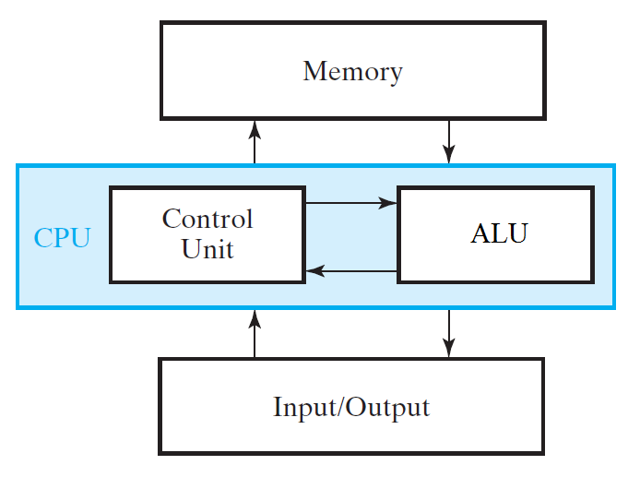
Components of Digital Computer
Computer uses these components in order to provide different functionalities (programs):
Memory stores program and data (input, output and intermediate data)
Central Processing Unit (CPU)
Performs Operations
Arithmetic Logic Unit (ALU) performs arithmetic and data-processing operations as specified by program
Control Unit supervises the flow of information between the various units
ALU and Control Unit together form CPU
Input Devices such as Mouse, Keyboard, DVD drives, CD-ROM, Microphones, Scanner, Webcam etc. are used to take data input in programs
Output Devices such as LCD, Printer and Loudspeakers etc. are used to present result to the user

Slide 4
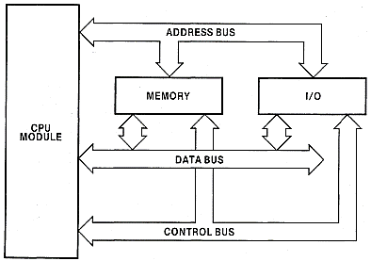
Microcomputer Block Diagram
Wires where CPU provides Address
Wires where Data travels for read and write
Read or Write Signal
Design of Simple 4-bit Processor

Slide 5
A Simple Program
A=15
B=12
C=5
D=10
D = D+C
A = A-C
B = B x C
…
How the processor executes this program?
Can you design a simple processor to execute this piece of code?

Slide 6
Simple Processor
Program |  | A | B | C | D
 |  | 0 | 0 | 0 | 0
A = 15
B = 12
C = 5
D = 10
D = D+C
A = A-C
B = B x C
…
How the processor initializes all the data to zero?
Data Assignment?
Can you implement this processor?
Writing on one of n memory cells?

Slide 7
Simple Processor
Program |  | A | B | C | D
 |  | 0 | 0 | 0 | 0
A = 15 |  | 15 | 0 | 0 | 0
B = 12 |  | 15 | 12 | 0 | 0
C = 5 |  | 15 | 12 | 5 | 0
D = 10 |  | 15 | 12 | 5 | 10
D = D+C
A = A-C
B = B x C
…
How the processor initializes all the data to zero?
Data Assignment?
Can you implement this processor?
Writing on one of n memory cells?
Notes:
D = D + C
A = A + B
C = C + D

Slide 8
A
4x1
Quad
MUX
Operand 1
B
X
C
D
Binary of
Operand 1
Adder
X+Y
A
4x1
Quad
MUX
Operand 2
What important signals do we need for
D = D + C
A = A + C
A = A + B
B
Y
C
D
Binary of
Operand 2
Notes:
D = D + C
A = A + B
C = C + D

Slide 9
A
4x1
Quad
MUX
Operand 1
B
X
C
D
Binary of
Operand 1
Adder
X+Y
A
4x1
Quad
MUX
Operand 2
What about
D = D x C
A = A - C
A = A x B
B
Y
C
D
Binary of
Operand 2
Notes:
A = A + C
A = A – C
A = A x C

Slide 10
Op1
Op1 + Op2
A
Adder
4x1
Quad
MUX
Op2
B
Op1
C
Op1
Op1 - Op2
D
Subtractor
Op2
Binary of
Operand 1
Op1
Multiplier
Op1 x Op2
A
Op2
What about following?
A = 10 (00)
A = A + C (01)
A = A – C (10)
A = A x B (11)
4x1
Quad
MUX
B
User Input
C
Op2
D
Binary of
Operand 2
Notes:
A = B x C, Op1 = (01) , Op2 = 10, Operation Multiply = (10), Dest Reg = (00)
A = 10

Slide 11
What about following?
A = A + C (00)
A = A – C (01)
A = A x B (10)
A = 10 (11)
Result of Adder
Result of Subtractor
4x1
Quad
MUX
Data to be updated
Result of Multiplier
User Input
Binary of
Operation

Slide 12
Op1
What about following?
A = A + C (00)
A = A – C (01)
A = A x B (10)
A = 10 (11)
A
Adder
4x1
Quad
MUX
Op2
B
Op1
C
Op1
D
Subtractor
Op2
00
Binary of
Operand 1
01
4x1
Quad
MUX
Op1
Multiplier
10
A
Op2
Data to be updated
4x1
Quad
MUX
11
B
User Input
C
Op2
D
Binary of
Operation
Binary of
Operand 2
Notes:
A = B x C, Op1 = (01) , Op2 = 10, Operation Multiply = (10), Dest Reg = (00)
A = 10

Slide 13
Binary for Destination Reg
Op1
Clks for Destination Reg
A
A
Adder
Op2
Reg A
4x1
Quad
MUX
B
2x4
Decoder
Op1
B
C
Reg B
Op1
D
Subtractor
Op2
00
C
Binary of
Operand 1
Reg C
4x1
Quad
MUX
Op1
Multiplier
10
D
A
Reg D
Op2
Data to be updated
4x1
Quad
MUX
11
B
User Input
C
Op2
D
Binary of
Operation
Binary of
Operand 2
Notes:
A = B x C, Op1 = (01) , Op2 = 10, Operation Multiply = (10), Dest Reg = (00)
A = 10

Slide 14
Microcomputer Block Diagram
Wires where CPU provides Address
Wires where Data travels for read and write
Read or Write Signal
Design of Simple 4-bit Processor

Slide 15
Address Bus
How Processor reads or write one out of n registers?
How Processor will read/write one cell out of 4 Bytes Memory?
How Processor will read/write one cell out of 16 Bytes Memory?
How Processor will read/write one cell out of 1MB Memory?
Address | Content
00
01
10
11
Address | Content
0000
0001
0010
0011
…
1111
Address
Address
CPU
CPU
Data
Data
4 Bytes
Memory
16 Bytes
Memory
What is the size of each Address Bus?

Slide 16
Address Bus
When a processor needs to read or write to a memory location, it specifies that memory location on the address bus (the value to be read or written is sent on the data bus).
Unidirectional – Address always travels from processor to memory.
An address bus is a computer bus (a series of lines/wires connecting two or more devices) that is used to specify a physical address.
The CPU uses the address bus to select the desired memory or I/0 device by providing a unique address that corresponds to one of the many memory or I/0 elements in the system.

Slide 17
Address Bus…
The number of address bus lines varies from one microcomputer to another.
The width of the address bus determines the amount of memory a system can address.
For example, a system with a 32-bit address bus can address 2³² memory locations.
If each memory location holds one byte, the addressable memory space is 4 GB (=2^2 x 2^30 Bytes).

Slide 18
Data Bus
What will be the size of data bus, for each of the following Memory configurations, if we want to read/write
2 Bytes per read/write operation?
4 Bytes per read/write operation?
Address | Content
00
01
10
11
Address | Content
0000
0001
0010
0011
…
1111
Address
Address
CPU
CPU
Data
Data
4 Bytes
Memory
16 Bytes
Memory
What is the size of each Data Bus?
Notes:
CPU will give the base address to read/write m bytes.

Slide 19
Data Bus
The data bus is the set of wires over which data passes between the CPU and the memory and I/0.
Bidirectional
The data can either be instructions for the CPU, or information the CPU is passing to or from I/0 ports.
Best and simplest operation requires the same size of data bus and memory cell width.
From one microcomputer to another, the number of bus lines may vary.
Notes:
Reference: iAPX 88 Book s-2
Data Bus = 4 Bits, 32 Bits,
Memory Size => 4 Bytes
2^20

Slide 20
Test you concepts
Given following specifications, determine the size of Data Bus and Address Bus:
A 64-Bit Machine with 2GB Memory
A 32-Bit Machine with 64MB Memory
A 16-Bit Machine with 1MB Memory (iAPX88)
Notes:
2 GB -→ 2^30 Bytes ….. 2^30 Cell……
Address Bus Size → 30 Lines
64MB = 64x2^20 Cells = 2^26 Cells
1MB = 1 Mega Bytes

Slide 21
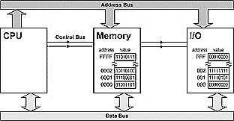
Test you concepts
What are Specifications of following system?
Notes:
2 GB -→ 2^30 Bytes ….. 2^30 Cell……
Address Bus Size → 30 Lines
64MB = 64x2^20 Cells = 2^26 Cells
1MB = 1 Mega Bytes

Slide 22
Control Bus
Control bus carries commands from the CPU and returns status signals from the devices.
For example, if the data is being read or written to the device the appropriate line (read or write) will be active (logic one).
Implementation of System Bus?
Notes:
Reference: iAPX 88 Book s-2

Slide 23
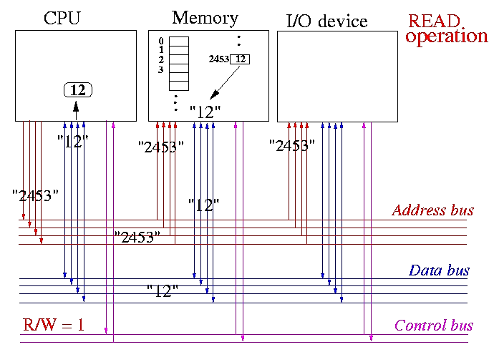
Read Data from Memory Cell no 2453
Notes:
- CPU sends out the address value 2453 on the address bus
- CPU sends out the signal R/W = 1 on the control bus, which indicates a READ operation
- CPU then waits for the data from memory on the data bus
- The R/W = 1 signal and the address bus value 2453 will cause the memory to retrieve the value at memory location 2453 to be sent out on the data bus
Reference: http://www.mathcs.emory.edu/~cheung/Courses/255/Syllabus/4-intro/mem-access.html

Slide 24
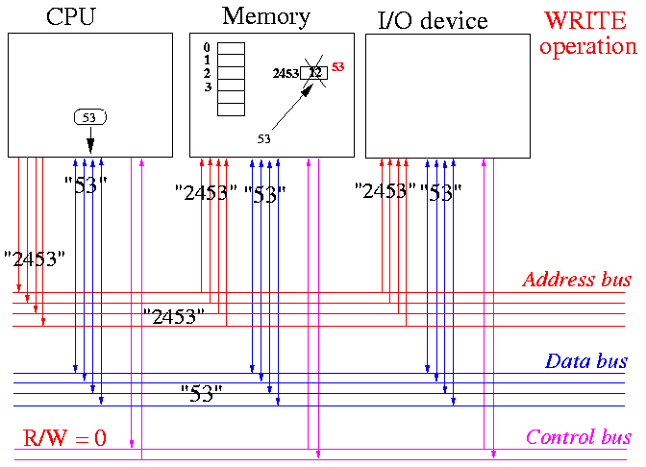
Write 53 on Memory Cell no 2453
Notes:
-CPU sends out the address value 2453 on the address bus
-CPU also sends out the value 53 on the data bus
-CPU now sends out the signal R/W = 0, which indicating a WRITE operation
-The R/W = 0 signal along with the address bus value 2453 and data bus value 53 will cause the memory to store the value 53 at the location 2453...
Reference: http://www.mathcs.emory.edu/~cheung/Courses/255/Syllabus/4-intro/mem-access.html

Slide 25
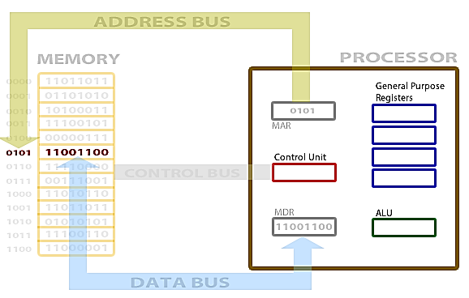
Another Read/Write Operation

Slide 26
Instruction Set
I₆-I₄ | I₃-I₂ | I₁ – I₀
Operation Code | 4-bit register operand 1(R1) | 4-bit register operand 2 (R2)
Operation Code | Operation Performed | Description
000 | R1 = Input A | Load the contents of input A in to the register operand 1 (R1).
001 | R1 = R2 | Move the contents of register operand 2 in to register operand 1.
010 | R1 = R1 + R2 | Add the contents of register operand 1 and register operand 2 and load in register operand 1.
011 | R1 = R1 - R2 | Subtract the contents of register operand 2 from register operand 1 and load in register operand 1.
100 | R1 = R1 * R2 | Multiply the contents of register operand 1 and register operand 2 and load in register operand 1 and 2. (As the result is of 8 bits)
101 | R1 = R1/2^{i} | Divide the register contents of register operand 1 with 2^{i} (i is an input) and load the result in register operand 1.
110 | R1 = R1*2^{I} | Multiply the register contents of register operand 1 with 2^{i} (i is an input) and load the result in register operand 1.
111 | R1 = R1 + R2 | Logical OR the contents of register operand 1 and register operand 2 and load in register operand 1.
Notes:
an instruction set architecture (ISA) is an abstract model of a computer

Slide 27
Executing Program on 4-Bit Simple Processor
High Level Language Code | Machine Code | A | B | C | D
 |  | 0 | 0 | 0 | 0
A = 15 | 000 00 XX
B = 12
C = 5
D = 10
D = D+C
A = A-C
B = B x C
…

Slide 28
Executing Program on 4-Bit Simple Processor…
High Level Language Code | Machine Code | A | B | C | D
 |  | 0 | 0 | 0 | 0
A = 15 | 000 00 XX
B = 12 | 000 01 XX
C = 5
D = 10
D = D+C
A = A-C
B = B x C
…

Slide 29
Executing Program on 4-Bit Simple Processor…
High Level Language Code | Machine Code | A | B | C | D
 |  | 0 | 0 | 0 | 0
A = 15 | 000 00 XX
B = 12 | 000 01 XX
C = 5 | 000 10 XX
D = 10 | 000 11 XX
D = D+C
A = A-C
B = B x C
…

Slide 30
Executing Program on 4-Bit Simple Processor…
High Level Language Code | Machine Code | A | B | C | D
 |  | 0 | 0 | 0 | 0
A = 15 | 000 00 XX
B = 12 | 000 01 XX
C = 5 | 000 10 XX
D = 10 | 000 11 XX
D = D+C | 010 11 10
A = A-C
B = B x C
…

Slide 31
Executing Program on 4-Bit Simple Processor…
High Level Language Code | Machine Code | A | B | C | D
 |  | 0 | 0 | 0 | 0
A = 15 | 000 00 XX
B = 12 | 000 01 XX
C = 5 | 000 10 XX
D = 10 | 000 11 XX
D = D+C | 010 11 10
A = A-C | 011 00 10
B = B x C
…

Slide 32
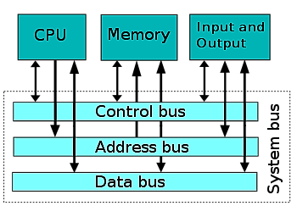
System Bus

Slide 33
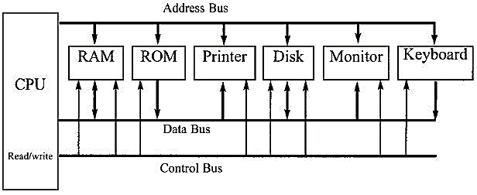
System Bus…
A peripheral or peripheral device is "an ancillary device used to put information into and get information out of the computer"

Slide 34
Homework
History of Processors
Processor specifications of your Personal Computer and Smart Phone

Slide 35
References
Chapter 1 of Lecture Notes (1.1 to 1.6)
iAPX88 Manual
http://www.mathcs.emory.edu/~cheung/Courses/255/Syllabus/4-intro/mem-access.html

